Slide 1

OSI Transport Layer
© 2007 Cisco Systems, Inc. All rights reserved.
Cisco Public
١

Slide 2
Objectives
Explain the role of Transport Layer protocols and services in supporting communications across data networks
Analyze the application and operation of TCP mechanisms that support reliability, reassembly and manage data loss.
Analyze the operation of UDP to support communicate between two processes on end devices
© 2007 Cisco Systems, Inc. All rights reserved.
Cisco Public
٢

Slide 3
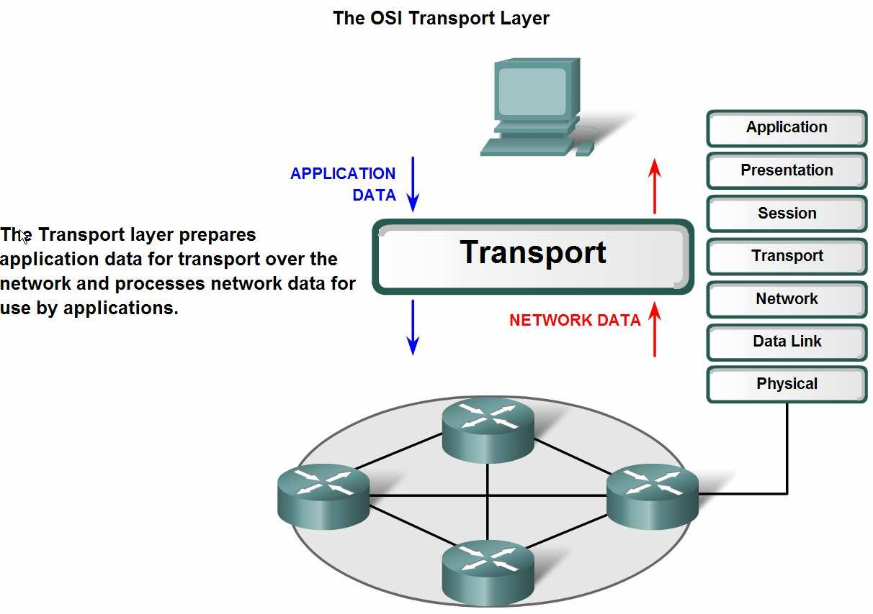
Transport Layer Role and Services
The purpose of the Transport layer
© 2007 Cisco Systems, Inc. All rights reserved.
Cisco Public
٣

Slide 4
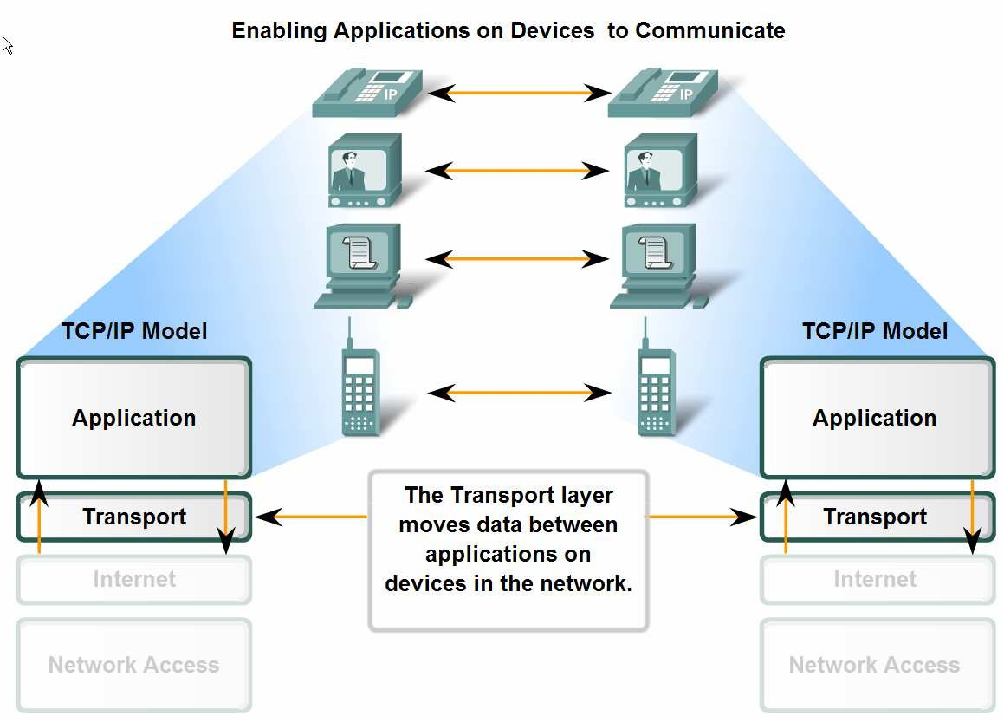
Transport Layer Role and Services
Provides the end-to-end transfer of data between applications.
© 2007 Cisco Systems, Inc. All rights reserved.
Cisco Public
٤

Slide 5
Role of the Transport layer
Encapsulating application data for use by the Network layer
Enables multiple applications to communicate over the network at the same time on a single device
Ensures that, if required, all the data is received reliably and in order by the correct application
Error handling mechanisms
© 2007 Cisco Systems, Inc. All rights reserved.
Cisco Public
٥

Slide 6
Responsibilities
Tracking the individual communication between applications on the source and destination hosts (Establishing a Session )
Segmenting data and managing each piece
Reassembling the segments into streams of application data
Identifying the different applications (Port Number)
© 2007 Cisco Systems, Inc. All rights reserved.
Cisco Public
٦

Slide 7
Two TCP/IP Transport layer protocols
  There are multiple Transport layer protocols. Why?
  Because different applications have different requirements.
© 2007 Cisco Systems, Inc. All rights reserved.
Cisco Public
٧

Slide 8
Two TCP/IP Transport layer protocols
The two most common
Transport layer protocols of TCP/IP protocol suite are Transmission Control Protocol (TCP)
User Datagram Protocol (UDP).
Both protocols manage the communication of multiple applications.
The differences between the two are the specific functions that each protocol implements.
© 2007 Cisco Systems, Inc. All rights reserved.
Cisco Public
٨

Slide 9
TCP/IP Transport layer protocols: TCP and UDP.
TCP at the Transport layer provide:
Connection-oriented conversations
Reliable delivery
Ordered data reconstruction
Flow control
© 2007 Cisco Systems, Inc. All rights reserved.
Cisco Public
٩

Slide 10
Basic characteristics of the UDP and TCP Protocols
UDP Protocol
Fast
Low overhead
Does not require acknowledgements
Does not resend lost data
Delivers data as it arrives
TCP Protocol
-Reliable
Acknowledges data
Resends lost data
Delivers data in the order sent
© 2007 Cisco Systems, Inc. All rights reserved.
Cisco Public
١٠

Slide 11
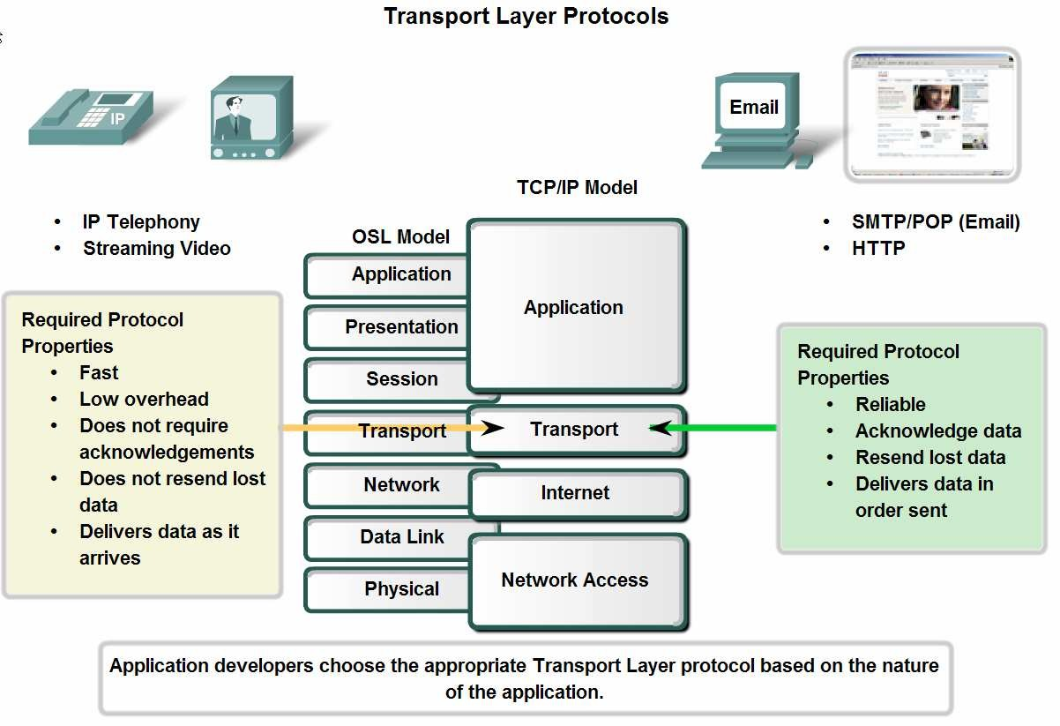
Transport Layer Role and Services
Supporting Reliable Communication
© 2007 Cisco Systems, Inc. All rights reserved.
Cisco Public
١١

Slide 12
UDP
UDP is a simple, connectionless protocol
Low overhead data delivery.
Datagrams are sent as "best effort" by this Transport layer protocol.
© 2007 Cisco Systems, Inc. All rights reserved.
Cisco Public
١٢

Slide 13
Applications that use UDP include:
Domain Name System (DNS)
Video Streaming
Voice over IP (VoIP)
© 2007 Cisco Systems, Inc. All rights reserved.
Cisco Public
١٣

Slide 14
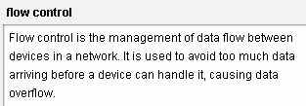
Transmission Control Protocol (TCP)
Connection-oriented protocol,
Overhead
Flow control
© 2007 Cisco Systems, Inc. All rights reserved.
Cisco Public
١٤

Slide 15
Applications that use TCP are:
Web Browsers
E-mail
File Transfers
© 2007 Cisco Systems, Inc. All rights reserved.
Cisco Public
١٥

Slide 16
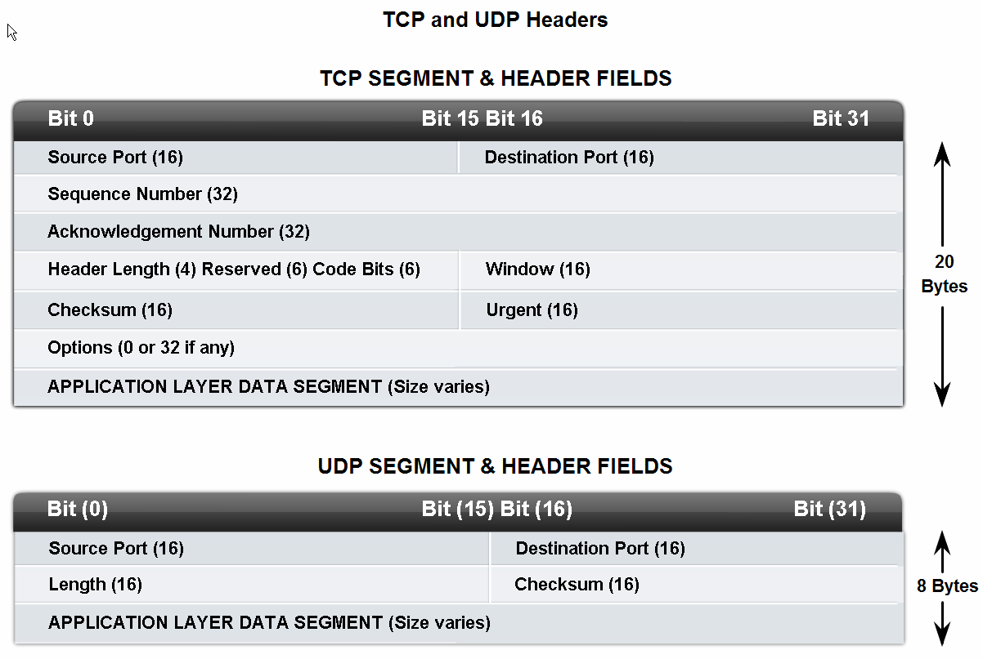
Transport Layer Headers
Segment or datagram?
© 2007 Cisco Systems, Inc. All rights reserved.
Cisco Public
١٦

Slide 17
Port Number, Identifying the Conversations
Port numbers are assigned in various ways,
Depending on whether the message is a request or a response.
Server processes have static port numbers assigned to them.
Clients dynamically choose a port number for each conversation.
© 2007 Cisco Systems, Inc. All rights reserved.
Cisco Public
١٧

Slide 18
Port Number
When a client application sends a request to a server application,
The destination port contained in the header is the port number that is assigned to the service daemon running on the remote host.
The client software must know what port number is associated with the server process on the remote host.
This destination port number is configured, either by default or manually.
For example, when a web browser application makes a request to a web server, the browser uses TCP and port number 80 unless otherwise specified. This is because TCP port 80 is the default port assigned to web-serving applications.
© 2007 Cisco Systems, Inc. All rights reserved.
Cisco Public
١٨

Slide 19
Socket & Port Number
The combination of the Transport layer port number and the Network layer IP address assigned to the host uniquely identifies a particular process running on a specific host device.
This combination is called a socket.
192.168.1.20:80.
© 2007 Cisco Systems, Inc. All rights reserved.
Cisco Public
١٩

Slide 20
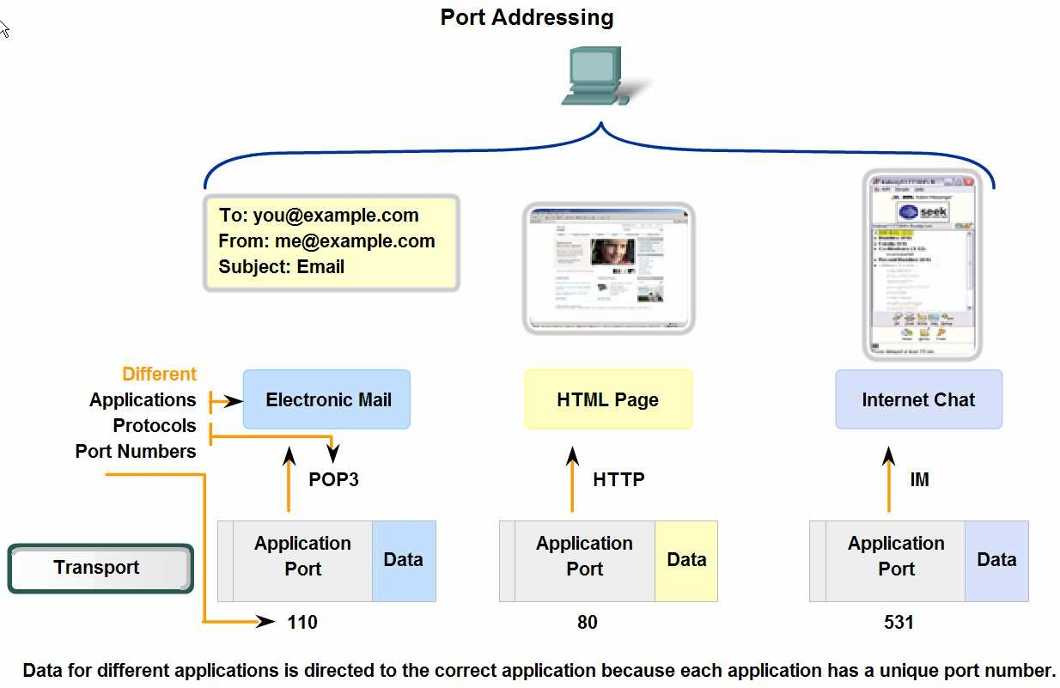
Data Delivery Based on Port Number
© 2007 Cisco Systems, Inc. All rights reserved.
Cisco Public
٢٠

Slide 21
There are different types of port numbers:
Well Known Ports (Numbers 0 to 1023)
These numbers are reserved for services and applications.
They are commonly used for applications such as HTTP (web server) POP3/SMTP (e-mail server) and Telnet.
  IANA (Internet assigned numbers authority)
Registered Ports (Numbers 1024 to 49151)
These port numbers are assigned to user processes or applications.
These processes are primarily individual applications that a user has chosen to install rather than common applications that would receive a Well Known Port.
These ports may also be used dynamically selected by a client as its source port.
© 2007 Cisco Systems, Inc. All rights reserved.
Cisco Public
٢١

Slide 22
Dynamic or Private Ports (Numbers 49152 to 65535)
These numbers are usually assigned dynamically to client applications when initiating a connection.
© 2007 Cisco Systems, Inc. All rights reserved.
Cisco Public
٢٢

Slide 23
Using both TCP and UDP
Some applications may use both TCP and UDP.
For example, the low overhead of UDP enables DNS to serve many client requests very quickly.
However Sometimes, sending the requested information may require the reliability of TCP.
In this case, the well known port number of 53 is used by both protocols with this service.
© 2007 Cisco Systems, Inc. All rights reserved.
Cisco Public
٢٣

Slide 24
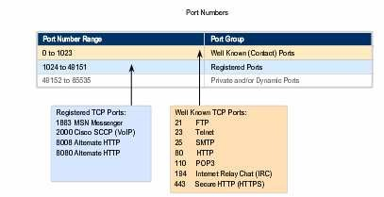
TCP Ports
© 2007 Cisco Systems, Inc. All rights reserved.
Cisco Public
٢٤

Slide 25
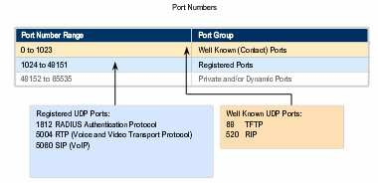
UDP Ports
© 2007 Cisco Systems, Inc. All rights reserved.
Cisco Public
٢٥

Slide 26
Netstat
Netstat provides information and statistics about protocols in use and current TCP/IP network connections and Port numbers.
(The name derives from the words network and statistics.)
For details
http://searchnetworking.techtarget.com/definition/netstat
© 2007 Cisco Systems, Inc. All rights reserved.
Cisco Public
٢٦

Slide 27
TCP Segments
Dividing application data into pieces both ensures that data is transmitted within the limits of the media and that data from different applications can be multiplexed on to the media.
© 2007 Cisco Systems, Inc. All rights reserved.
Cisco Public
٢٧

Slide 28
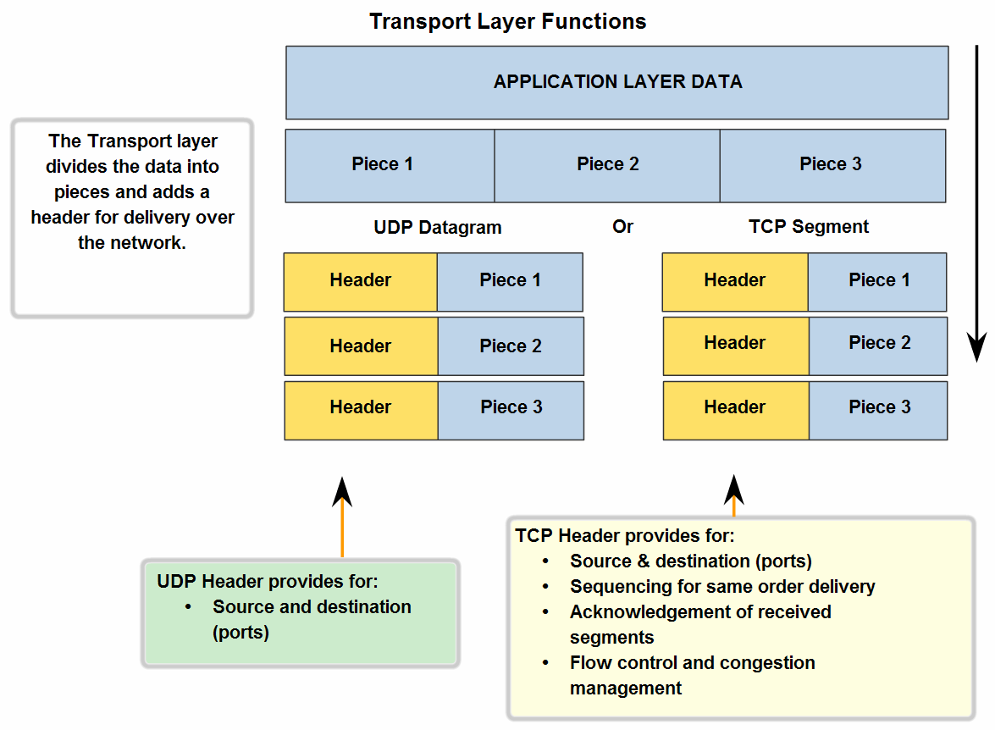
Segments
© 2007 Cisco Systems, Inc. All rights reserved.
Cisco Public
٢٨

Slide 29
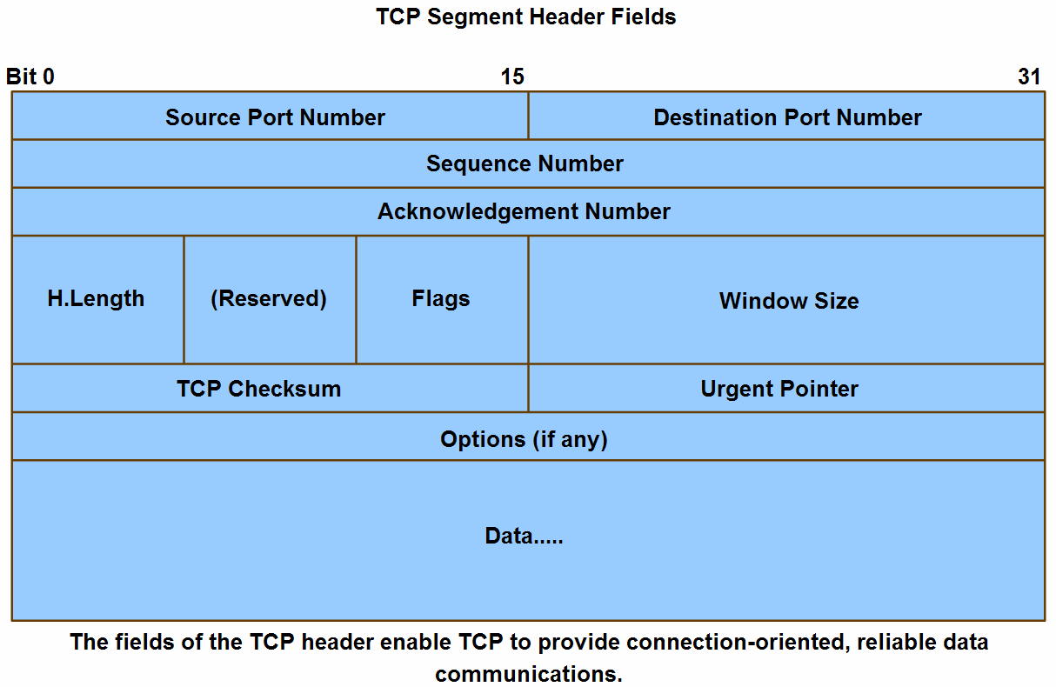
TCP Segment Header
© 2007 Cisco Systems, Inc. All rights reserved.
Cisco Public
٢٩

Slide 30
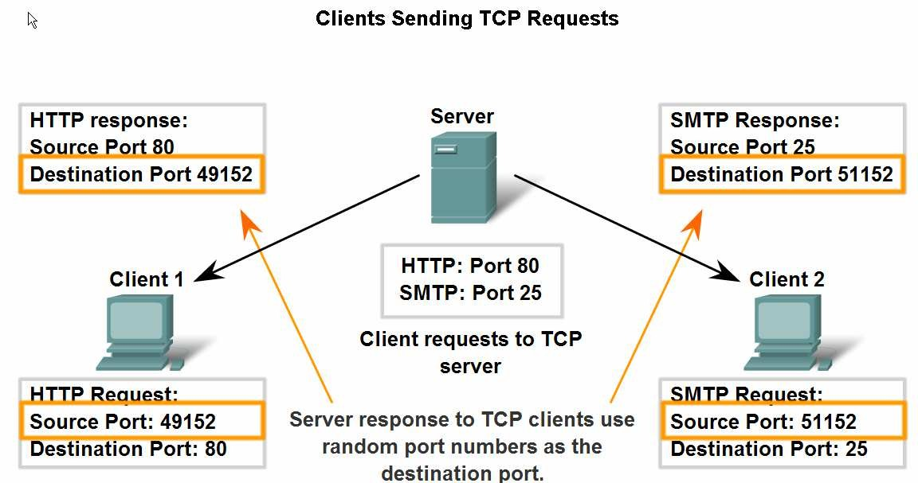
Application and Operation of TCP Mechanisms
Port numbers in establishing TCP sessions and directing segments to server process
© 2007 Cisco Systems, Inc. All rights reserved.
Cisco Public
٣٠

Slide 31
TCP Connection Establishment and Termination
When two hosts communicate using TCP, a connection is established before data can be exchanged.
After the communication is completed, the sessions are closed and the connection is terminated.
The connection and session mechanisms enable TCP's
reliability function.
© 2007 Cisco Systems, Inc. All rights reserved.
Cisco Public
٣١

Slide 32
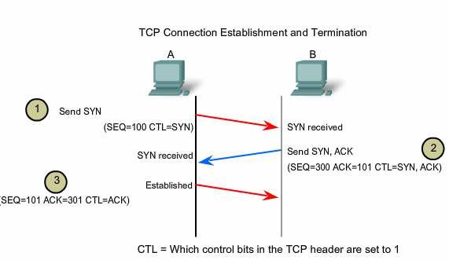
Handshake in the establishment of TCP sessions
© 2007 Cisco Systems, Inc. All rights reserved.
Cisco Public
٣٢

Slide 33
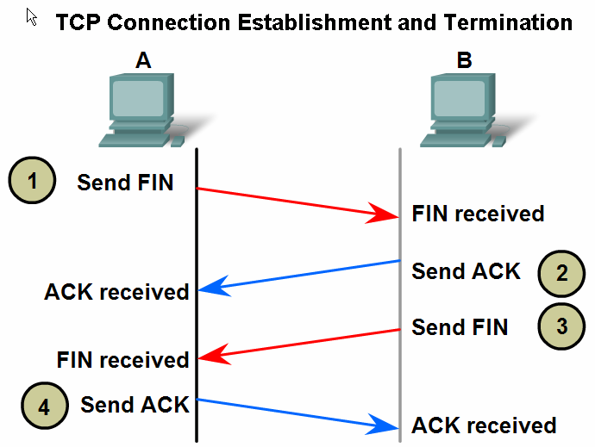
Handshake in the termination of TCP sessions
© 2007 Cisco Systems, Inc. All rights reserved.
Cisco Public
٣٣

Slide 34
The sequence number is the relative number of bytes that have been transmitted in this session plus 1.
Acknowledgement number indicate the next byte in this session that the receiver expects to receive.
© 2007 Cisco Systems, Inc. All rights reserved.
Cisco Public
٣٧

Slide 35
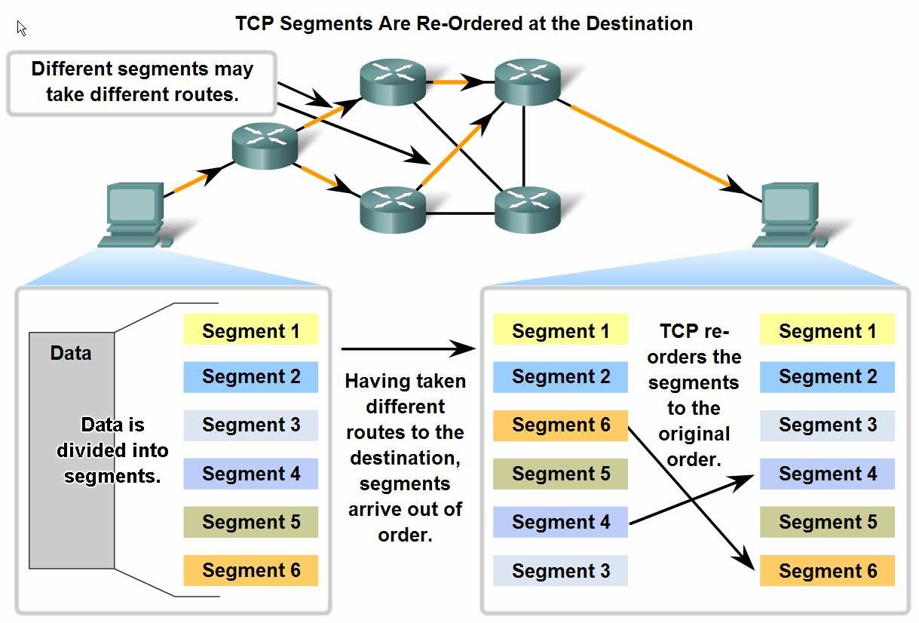
Managing TCP Sessions
TCP sequence numbers are used to reconstruct the data stream with segments placed in the correct order
© 2007 Cisco Systems, Inc. All rights reserved.
Cisco Public
٣٨

Slide 36
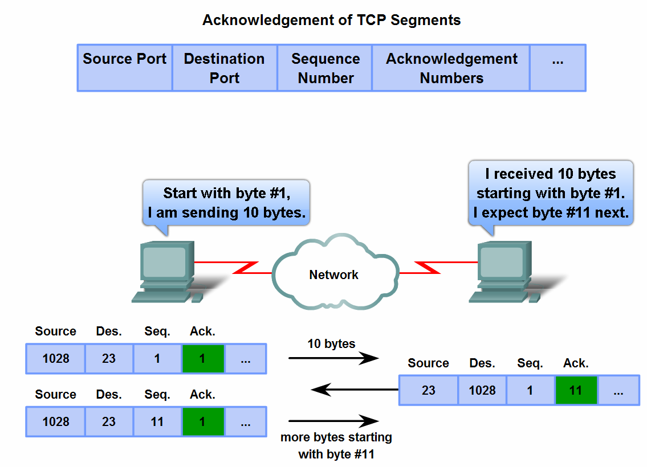
Managing TCP Sessions
Trace the steps used by the TCP protocol in which sequence numbers and acknowledgement numbers are used to manage exchanges in a conversation
© 2007 Cisco Systems, Inc. All rights reserved.
Cisco Public
٣٩

Slide 37
Window Size
The amount of data that a source can transmit before an acknowledgement must be received is called the window size.
Window Size is a field in the TCP header that enables the management of lost data and flow control.
Sliding window refers to the fact that the window size is negotiated dynamically during the TCP session
© 2007 Cisco Systems, Inc. All rights reserved.
Cisco Public
٤٠

Slide 38
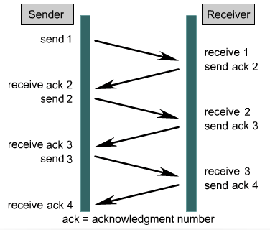
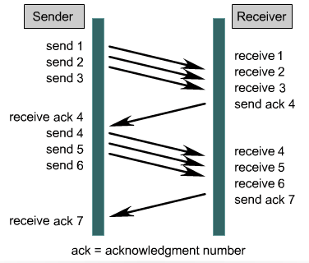
TCP Windows and Flow Control
Data often is too large to be sent in a single segment. TCP splits the data into multiple segments.
TCP provides flow control through “windowing” to set the pace of how much data is sent at a time – IE how many bytes per window, and how many windows between ACKs.
Window Size = 1
Window Size = 3

Slide 39
TCP Retransmission
For example,
If segments with sequence numbers 1500 to 3000 and 3400 to 3500 were received, the ack number would be 3001.
This is because there are segments with the sequence numbers 3001 to 3399 that have not been received.
When TCP at the source host has not received an ack after a predetermined amount of time, it will go back to the last acknowledgement number that it received and retransmit data from that point forward.
© 2007 Cisco Systems, Inc. All rights reserved.
Cisco Public
٤١

Slide 40
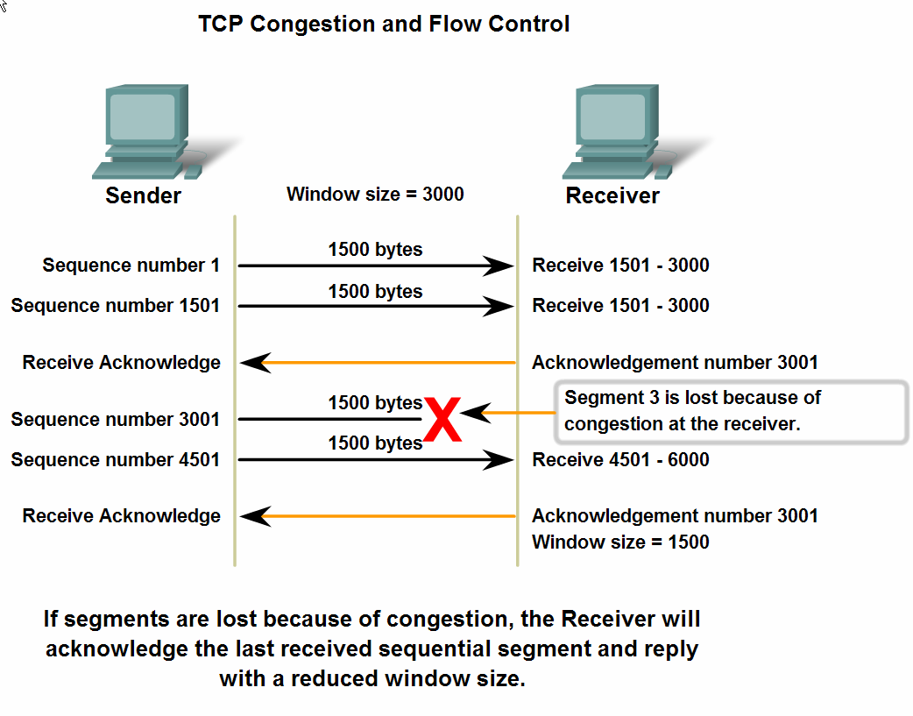
Flow Control
Window size, and congestion during a session
© 2007 Cisco Systems, Inc. All rights reserved.
Cisco Public
٤٢

Slide 41
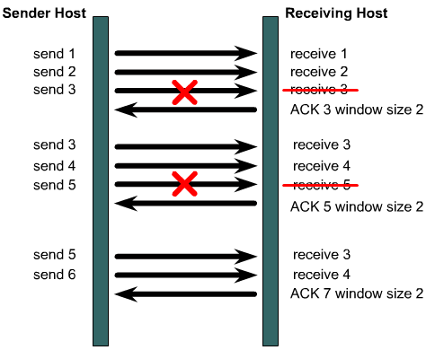
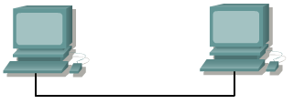
Flow Control
Fast enough for you?
I didn’t get all of that, slow down.
If the source receives no acknowledgment, it knows to retransmit at a slower rate.

Slide 42
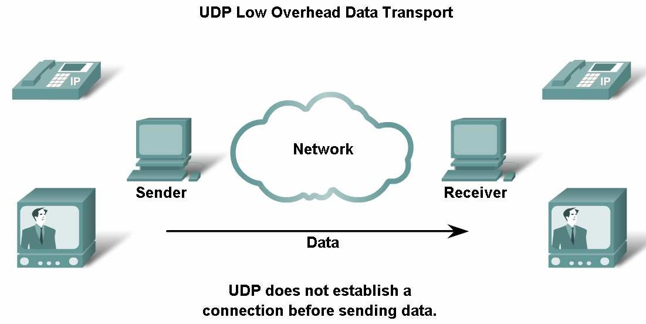
UDP Protocol
© 2007 Cisco Systems, Inc. All rights reserved.
Cisco Public
٤٣

Slide 43
UDP Protocol
UDP is a simple protocol that provides the basic Transport layer functions.
It has a much lower overhead than TCP, since it is not connection-oriented and does not provide the sophisticated retransmission, sequencing, and flow control mechanisms.
© 2007 Cisco Systems, Inc. All rights reserved.
Cisco Public
٤٤

Slide 45
UDP Protocol
Key Application layer protocols that use UDP include:
Domain Name System (DNS)
Simple Network Management Protocol (SNMP)
Dynamic Host Configuration Protocol (DHCP)
Routing Information Protocol (RIP)
Trivial File Transfer Protocol (TFTP)
Online games
© 2007 Cisco Systems, Inc. All rights reserved.
Cisco Public
٤٥

Slide 46
UDP Reassembles
UDP does not keep track of sequence numbers the way TCP does.
UDP has no way to reorder the datagrams into their transmission order.
UDP simply reassembles the data in the order that it was received and forwards it to the application.
If the sequence of the data is important to the application, the application will have to identify the proper sequence of the data and determine how the data should be processed.
© 2007 Cisco Systems, Inc. All rights reserved.
Cisco Public
٤٦

Slide 47
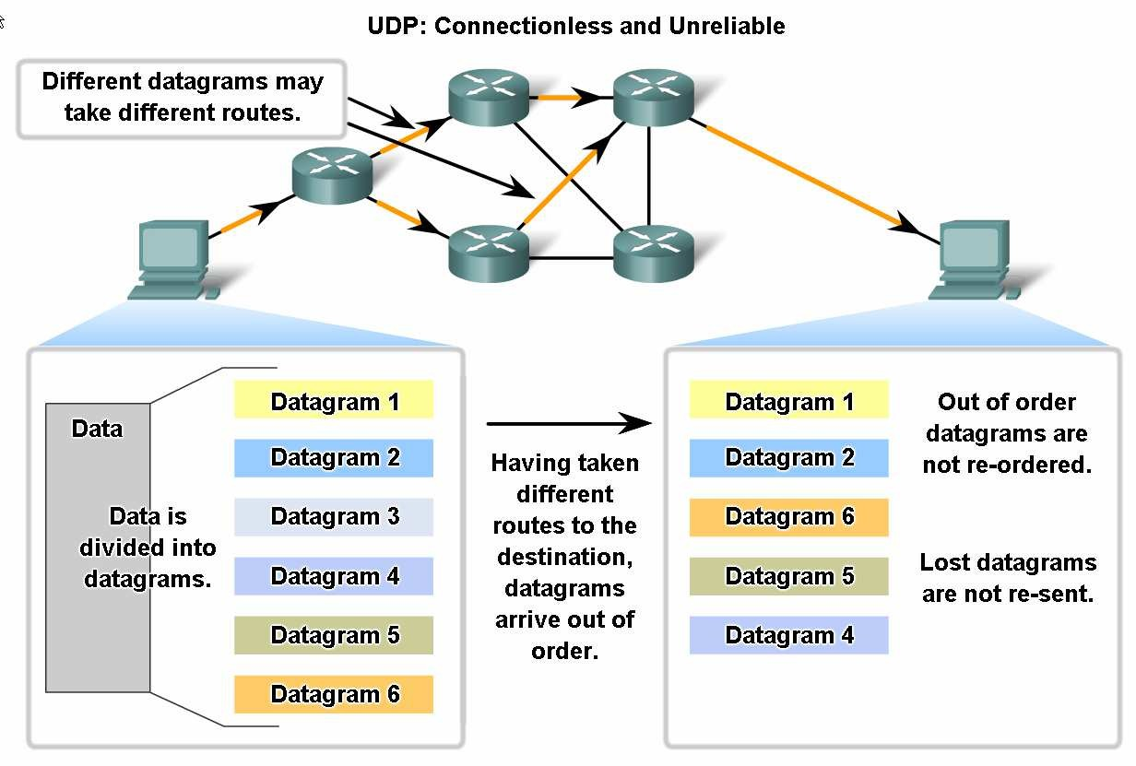
UDP Protocol
© 2007 Cisco Systems, Inc. All rights reserved.
Cisco Public
٤٧

Slide 48
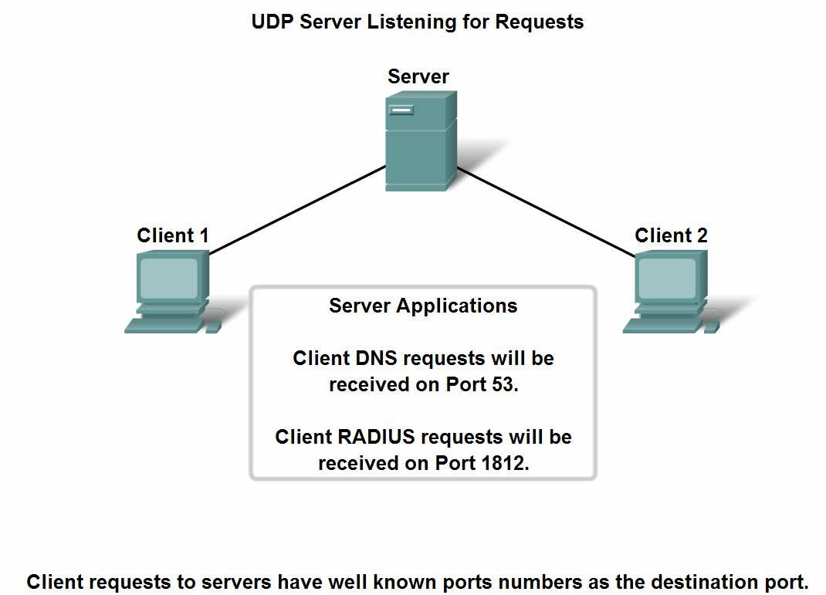
UDP Protocol – Port Number
Servers use port numbers to identify a specified application layer process and direct segments to the proper service or application
© 2007 Cisco Systems, Inc. All rights reserved.
Cisco Public
٤٨

Slide 49
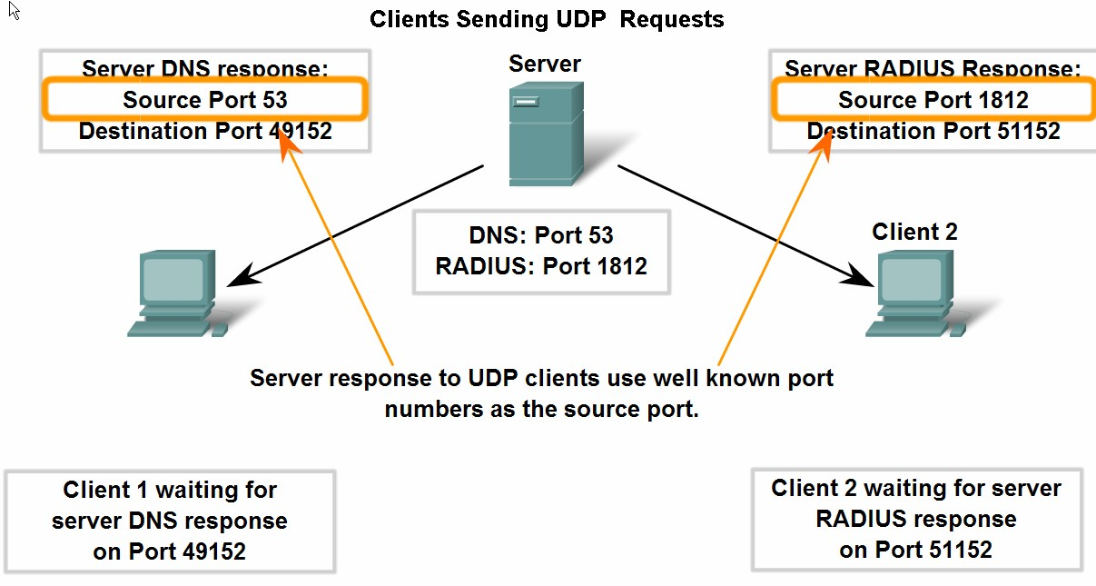
UDP Protocol
Trace the steps as the UDP protocol and port numbers are utilized in client-server communication.
© 2007 Cisco Systems, Inc. All rights reserved.
Cisco Public
٤٩

Slide 50


Denial of Service Attacks
DoS attacks are designed to deny services to legitimate users.
DoS attacks are used by hackers to overwhelm and crash systems.
SYN flooding is a DoS attack that exploits the three way handshake.
Hacker initiates a SYN but spoofs the source IP address.
Send SYN
Target replies to the unreachable IP address and waits for final ACK.
Send SYN
Receive SYN
Send SYN
Send SYN/ACK
Send SYN
Send SYN
Hackers floods target with false SYN requests tying up its connection resources, preventing it from responding to legitimate connection requests.
Send SYN
To defend against these attacks, decrease the connection timeout period and increase the connection queue size. Software also exists that can detect these types of attacks and initiate defensive measures.
Notes:
One type of DoS is known as SYN flooding. SYN flooding exploits the normal three-way handshake and causes targeted devices to acknowledge to source addresses that will not complete the handshake.

Slide 51
UDP Port Numbers
Echo 7 Echo user datagram back to user
Discard 9 Discard user datagrams
Daytime 13 Report time in a user friendly fashion
Quote 17 Return "Quote of the day"
Chargen 19 Character generator
Nameserver 53 Domain Name Server
Sql-Net 66 Oracle Sequel Network
BOOTPS 67 Server port to download configuration information
BOOTPC 68 Client port to receive configuration information
TFTP 69 Trivial File Transport Protocol
POP3 110 Post Office Protocol - V3
SunRPC 111 Sun Remote Procedure Call
NTP 123 Network Time Protocol
SNMP 161 Used to receive network management queries
SNMP-trap 162 Used to receive network problem reports.
IRC 194 Internet Relay Chat
IPX 213 IPX - IP Tunneling
SysLog 514 System Log
RIP 520 Routing Information Protocol
NFS 2049 Network File Service

Slide 52
TCP vs UDP
TCP | UDP
Connection-oriented delivery | Connectionless delivery, faster
Uses windows and ACKs | No windows or ACKs
Full header | Smaller header, less overhead
Sequencing | No sequencing
Provides reliability | Relies on app layer protocols for reliability
FTP, HTTP, SMTP, and DNS | DNS, TFTP, SNMP, and DHCP

Slide 53
Some Well-Known TCP Ports
Port Application Description
9 Discard Discard all incoming data port
7 Echo Echo
19 Chargen Exchange streams of data port
20 FTP-Data File transfer data port
21 FTP-CMD File transfer command port
23 Telnet Telnet remote login port
25 SMTP Simple Mail Transfer Protocol port
53 DOMAIN Domain Name Service
79 Finger Obtains information about active users
80 HTTP Hypertext Transfer Protocol port
88 Kerberos Authentication Protocol
110 POP3 PC Mail retrieval service port
119 NNTP Network news access port
161 SMTP Network Management
179 BGP Border Gateway Protocol
513 Rlogin Remote Login In

Slide 54
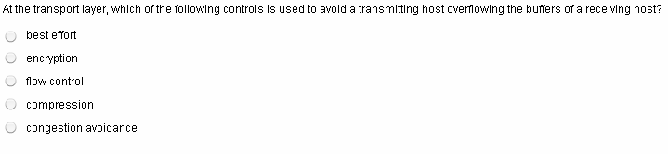
Quiz
© 2007 Cisco Systems, Inc. All rights reserved.
Cisco Public
٥٠

Slide 55
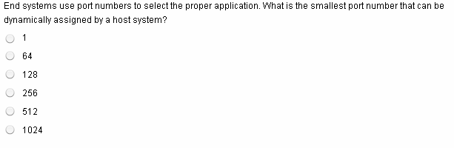
© 2007 Cisco Systems, Inc. All rights reserved.
Cisco Public
٥١

Slide 56
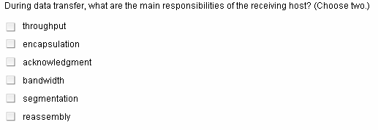
© 2007 Cisco Systems, Inc. All rights reserved.
Cisco Public
٥٢

Slide 57
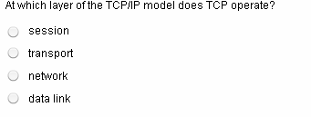
© 2007 Cisco Systems, Inc. All rights reserved.
Cisco Public
٥٣

Slide 58
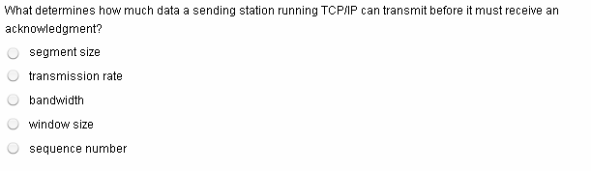
© 2007 Cisco Systems, Inc. All rights reserved.
Cisco Public
٥٤

Slide 59
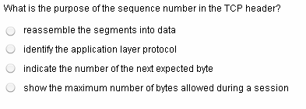
© 2007 Cisco Systems, Inc. All rights reserved.
Cisco Public
٥٥

Slide 60
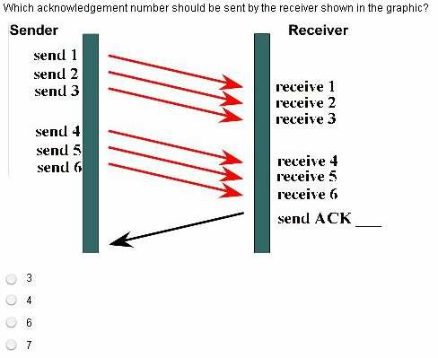
© 2007 Cisco Systems, Inc. All rights reserved.
Cisco Public
٥٦

Slide 61
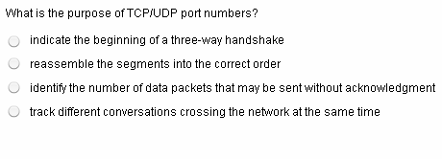
© 2007 Cisco Systems, Inc. All rights reserved.
Cisco Public
٥٧

Slide 62
© 2007 Cisco Systems, Inc. All rights reserved.
Cisco Public
٥٨

